Slide 1

Overview of
Quantitative
Feedback
Theory
(QFT)
Presenter:
Job Ledezma
Genova, Italy – May 2016

Slide 2
Plant Model
+
Uncertainty
Performance
Specifications
Robustness
Performance
QFT
Controller
Design
Bounds
Loopshaping
F
+
G

Slide 3
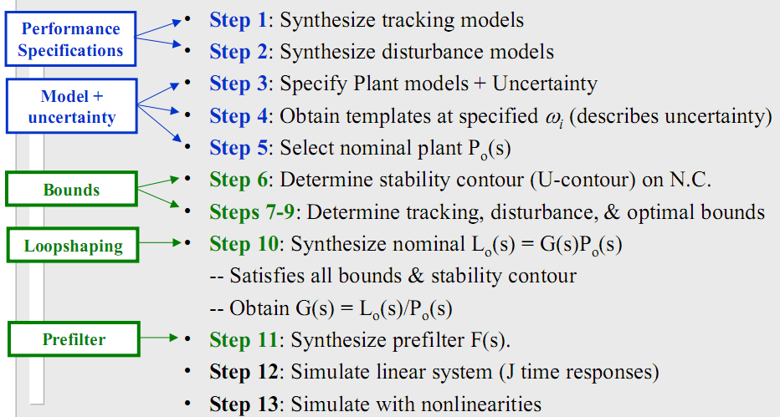
QFT Procedure

Slide 4
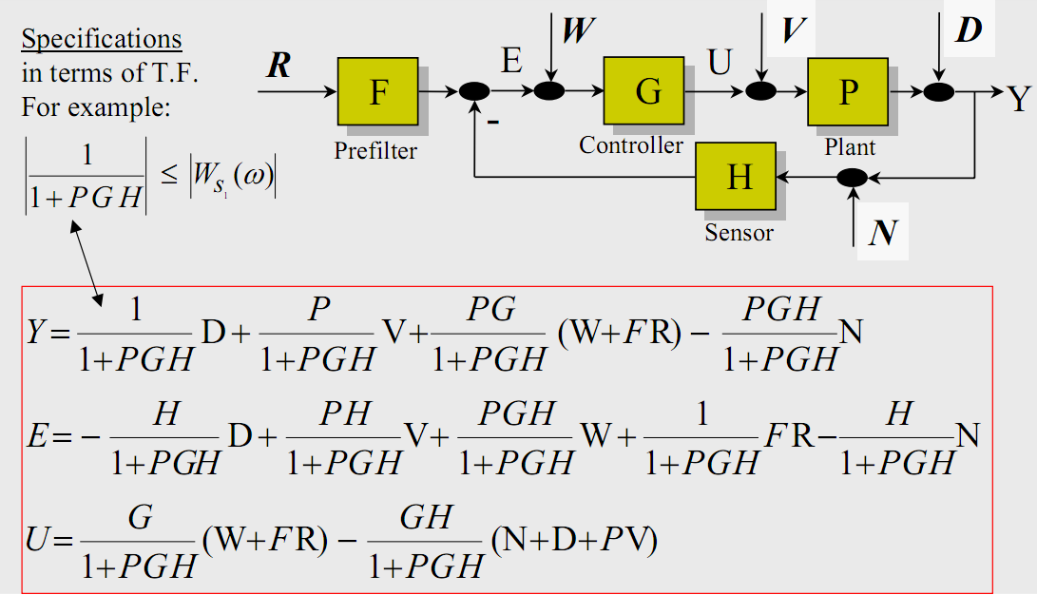
QFT Procedure
Step 1: Synthesize Tracking Models
Step 2: Disturbance Models

Slide 5
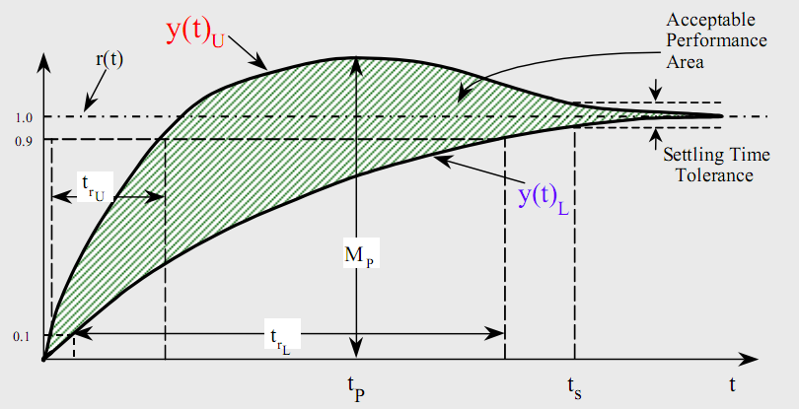
QFT Procedure
Time-Domain Specifications: Desire system output y(t) to lie between specified upper and lower bounds, y(t)U and y(t)L, respectively

Slide 6
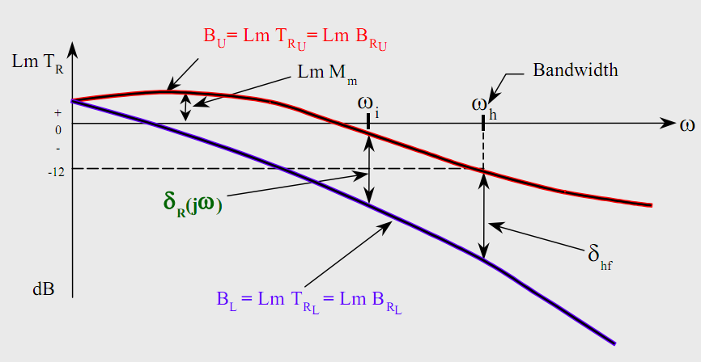
QFT Procedure
Frequency Domain: BU and BL are the upper and lower bounds respectively.

Slide 7
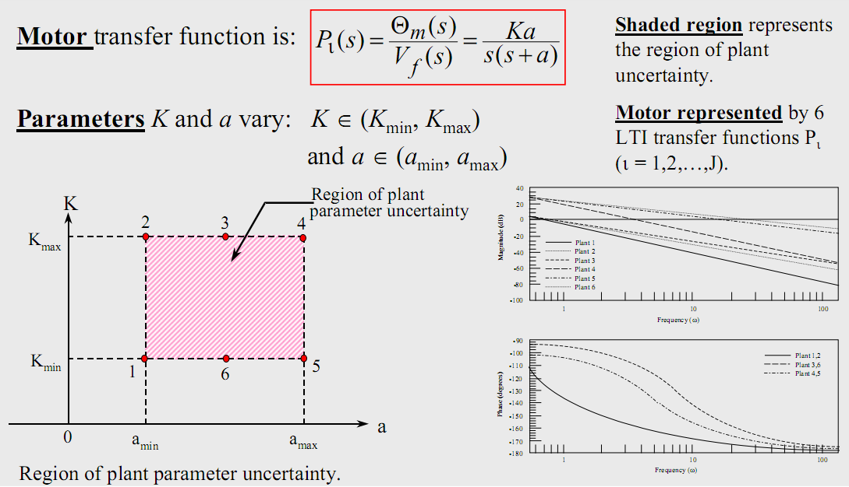
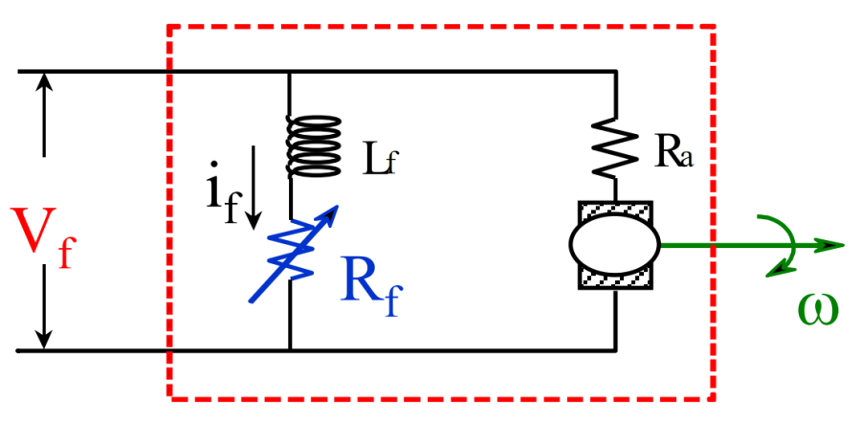
QFT Procedure
Step 3: Plant Model + Uncertainty

Slide 8
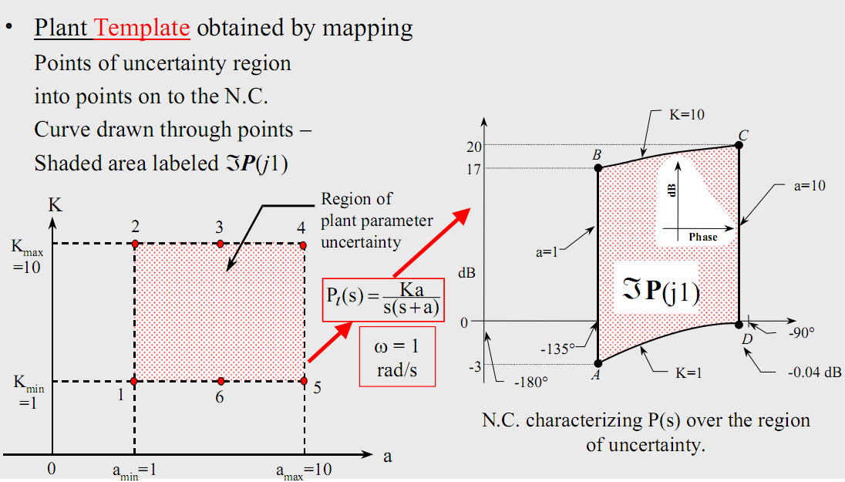
QFT Procedure
Step 4: Templates

Slide 9
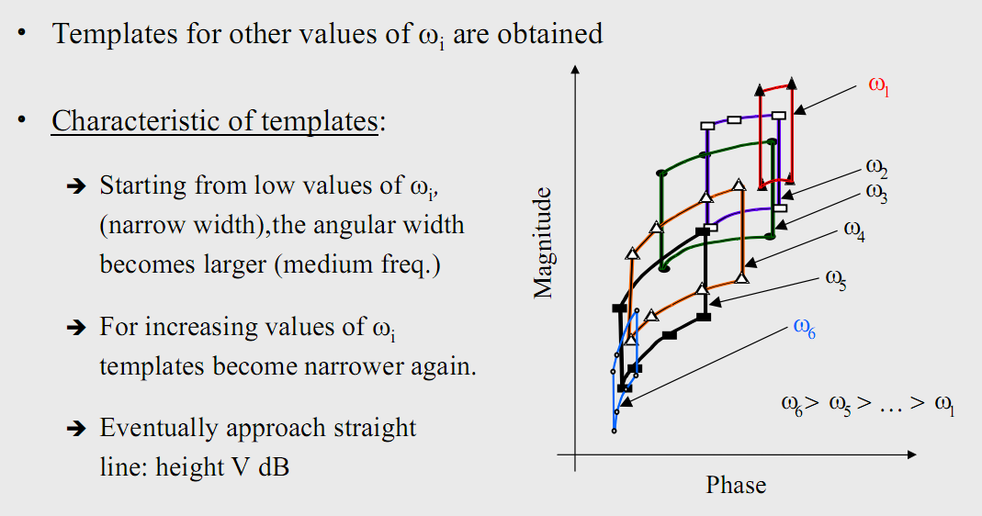
QFT Procedure

Slide 10
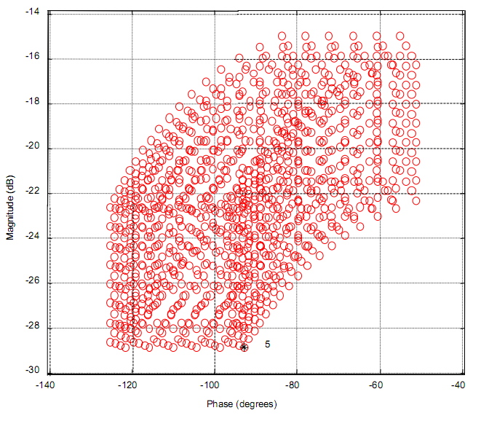
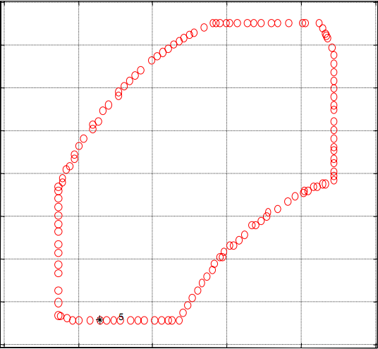
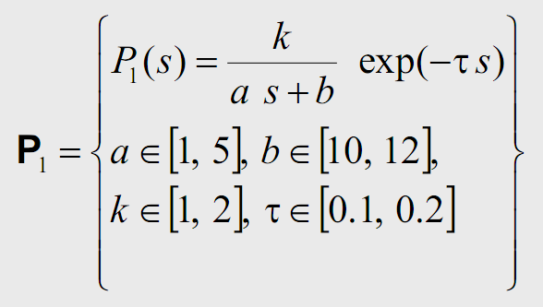
QFT Procedure
Example:
4-dimensional parameter space.

Slide 11
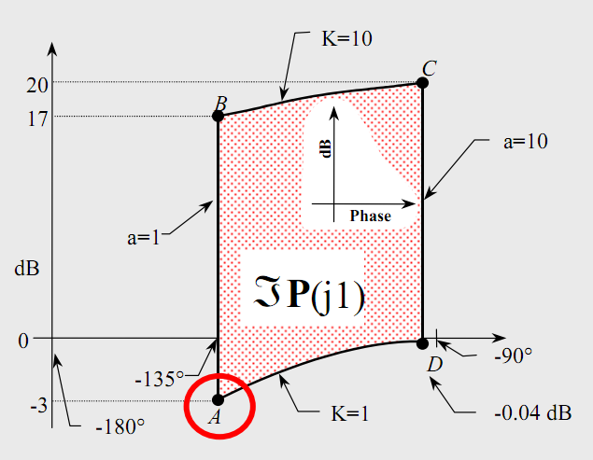
QFT Procedure
Step 5: Nominal plant
Chose any plant.
Keep the same plant as the nominal for all frequencies.

Slide 12
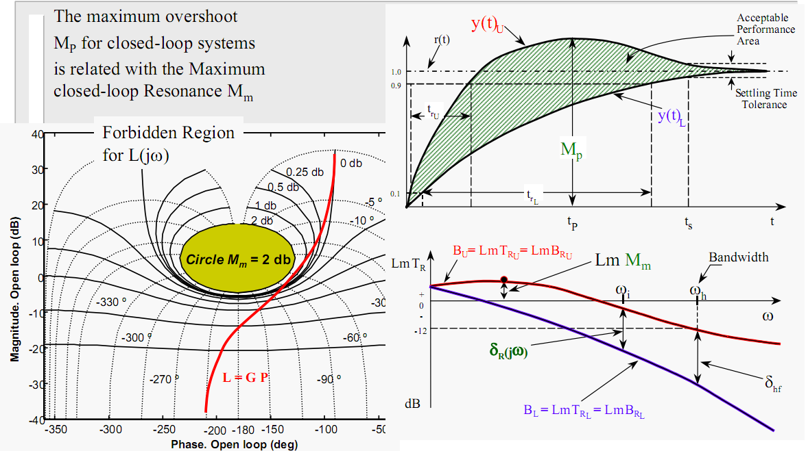
QFT Procedure
Step 6: U-Contour (Stability Bound)

Slide 13
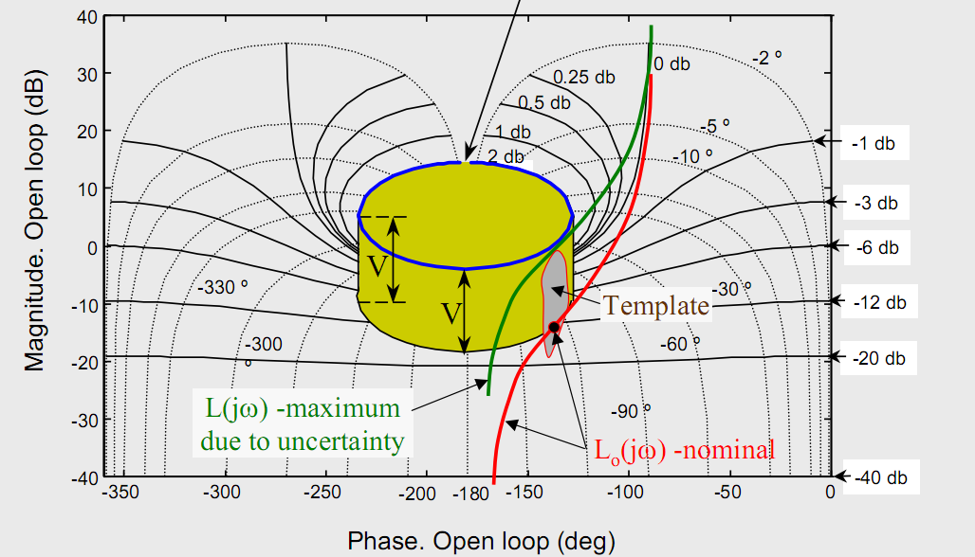
QFT Procedure

Slide 14
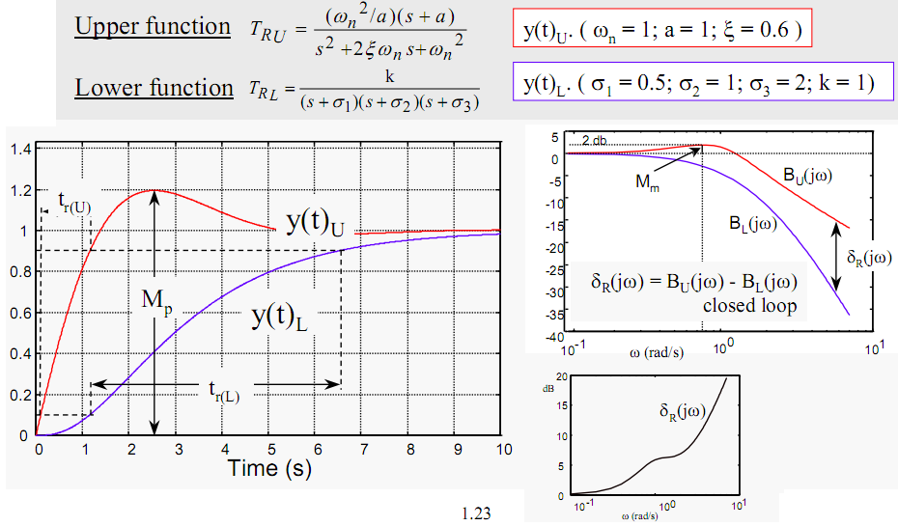
QFT Procedure
Step 7: Tracking Bounds

Slide 15
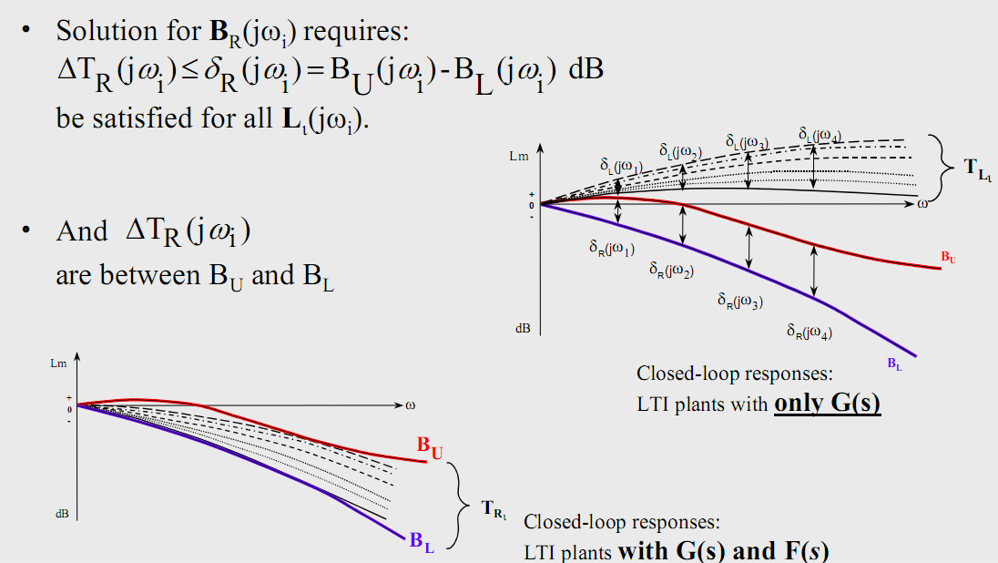
QFT Procedure

Slide 16
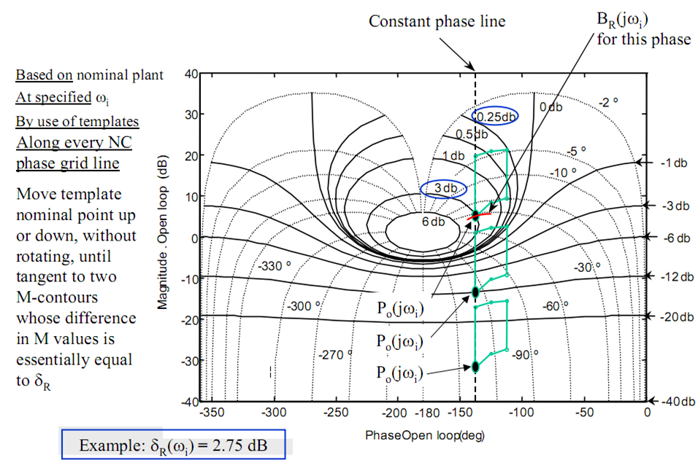
Classical Graphical Procedure

Slide 17
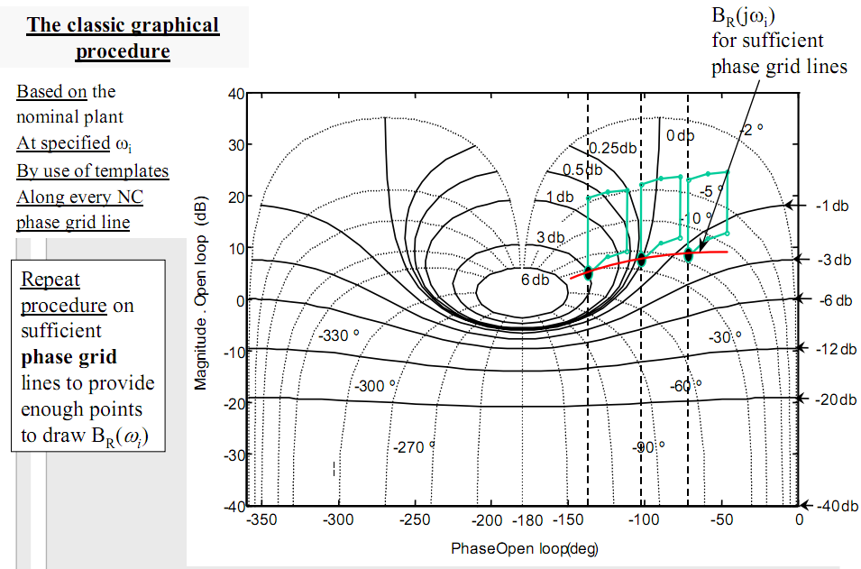
Classical Graphical Procedure

Slide 18
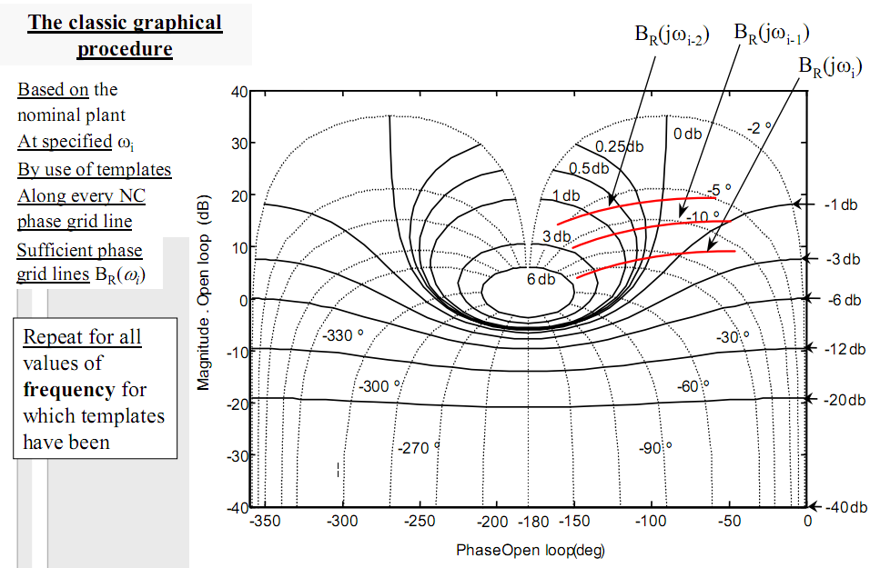
Classical Graphical Procedure

Slide 19
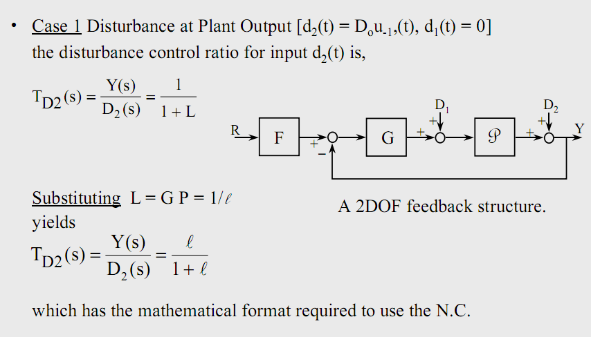
QFT Procedure
Step 8: Disturbance Rejection Bounds

Slide 20
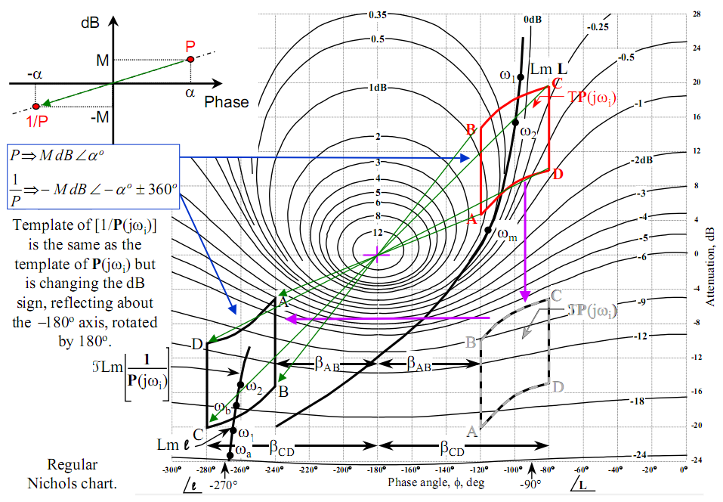
QFT Procedure

Slide 21
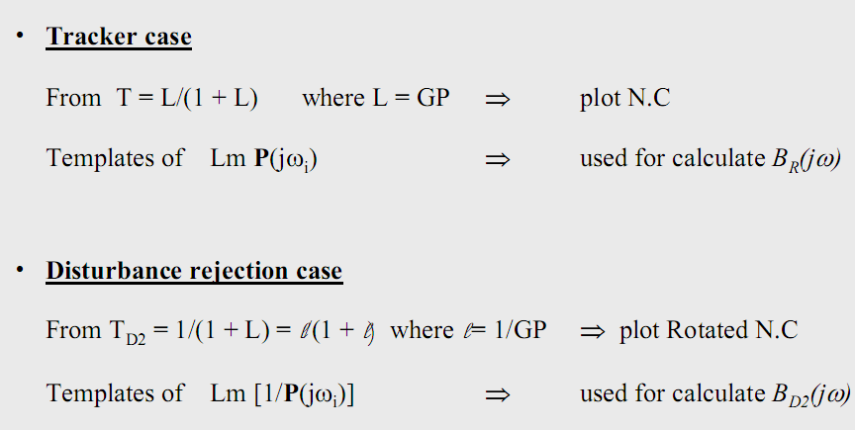
QFT Procedure

Slide 22
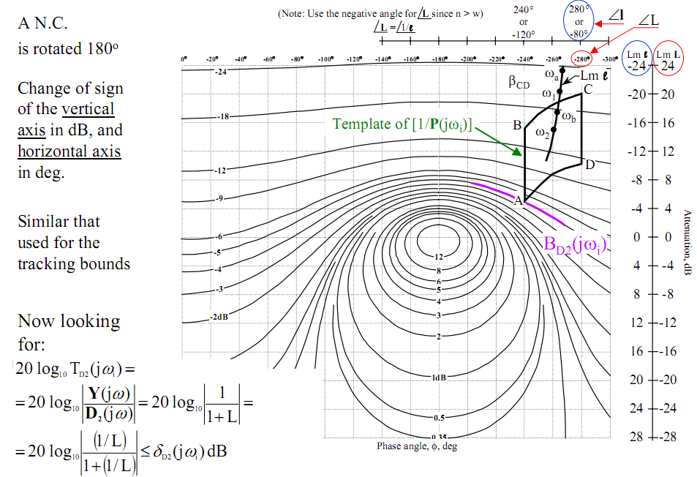
QFT Procedure

Slide 23
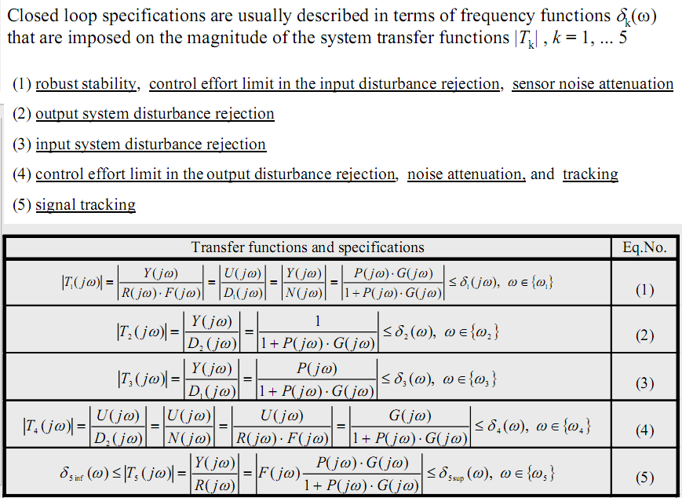
Modern Graphical Procedure

Slide 24
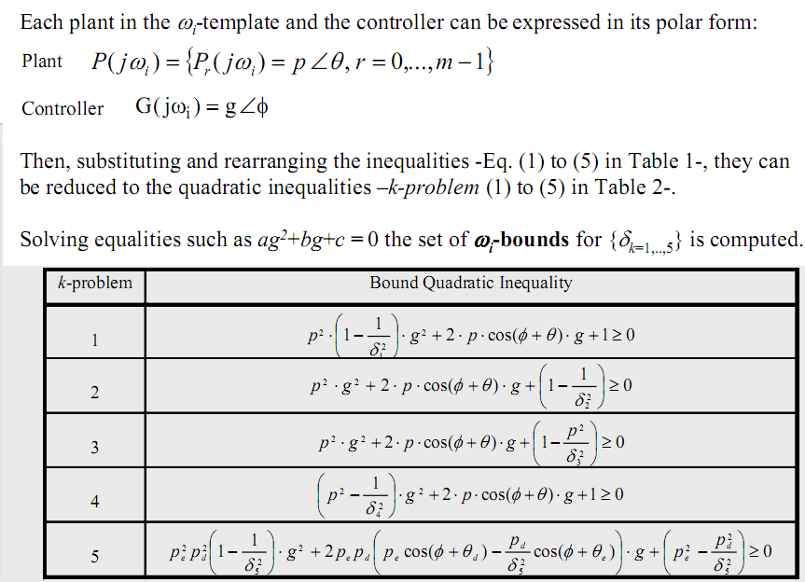
Modern Graphical Procedure

Slide 25
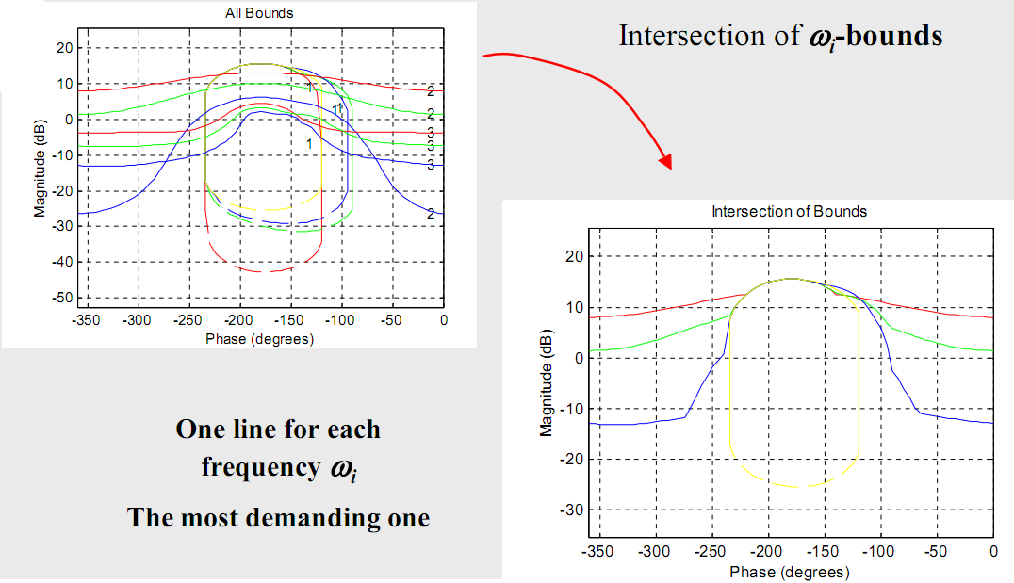
QFT Procedure
Step 9: Optimal Bounds

Slide 26
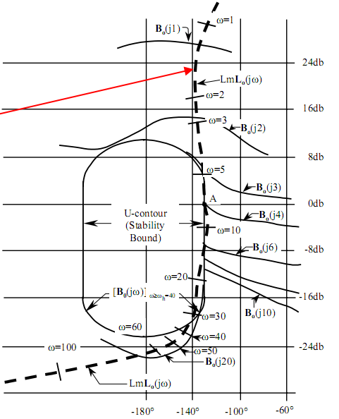
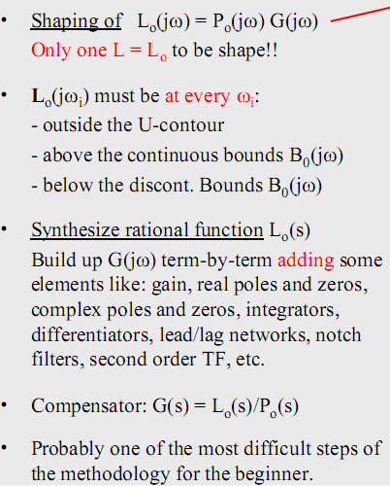
QFT Procedure
Step 10: Loopshaping

Slide 27
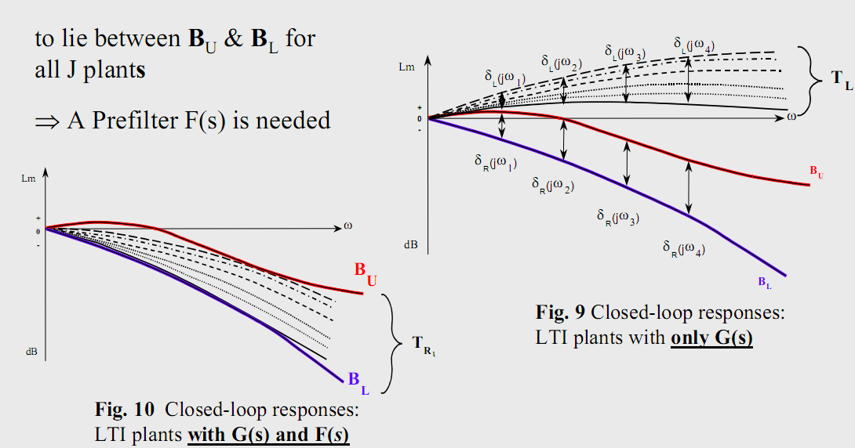
QFT Procedure
Step 11: Prefilter Design

Slide 28
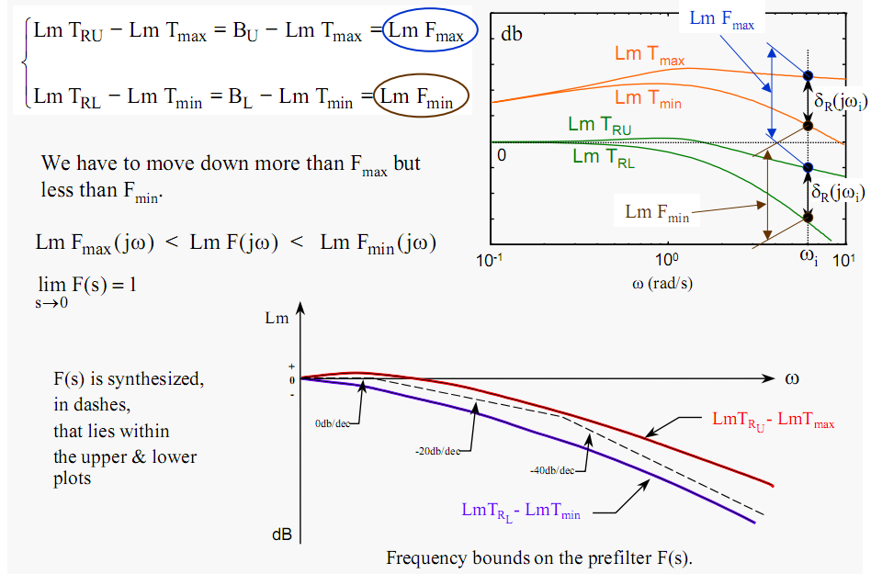
QFT Procedure

Slide 29
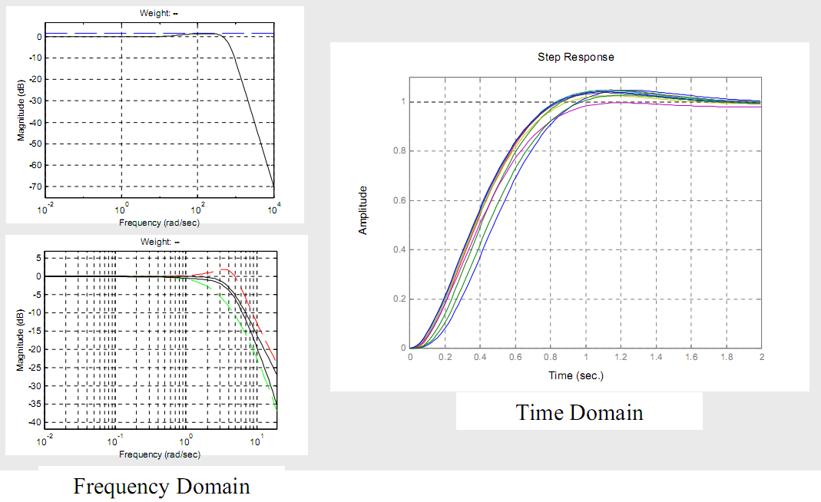
QFT Procedure
Step 12: Simulate Linear System
Step 13: Simulate with Nonlinearities

Slide 30

?
?
?
Any questions ??
Thanks !
?

